Slide 1


Data Scouts Think | Create | Innovate NPCI Fintech Hackathon

Slide 2
Objective : Opportunity Mapping for Promotion of UPI in India
How?
Where?
Who?
Solution
India is one of the fastest growing economies with high adoption rate towards internet and mobile technology
It is expected to have 500 million smartphone users by end of 2018 and the internet tariffs are continuously falling down
The Finance Ministry of India aims for 25 billion digital payments in 2017-18
This project aims to increase the penetration of UPI in the rural India by identifying the states which are highly probable to digitalize their payment methods

Slide 3

The Solution
Driving Digital Payments in Rural Infrastructure

Slide 4
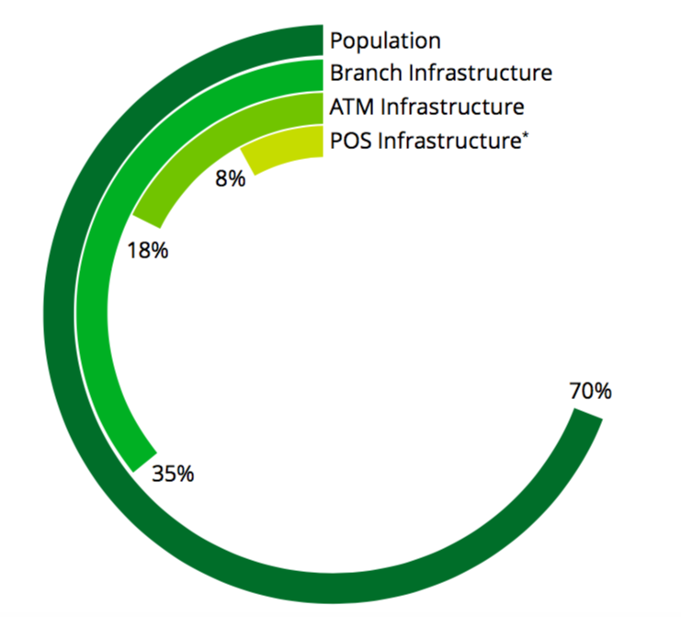
Digital Appetite of Rural India
Rural population constitutes 70% of the total population
Only 35% can avail Branch Infrastructure in Rural Areas
Only 18% can avail the ATM Facilities
Only 8% can make use of POS Infrastructure
Gap needs to be filled!
Widespread Digital payments require a behavioural shift
P2P and P2M payments are largely done in cash and provide immense scope for growth
Technologies like AEPS or payments through IVR are easy to use and can be adopted in rural areas

Slide 5
Opportunity Mapping in Rural Landscape

Slide 6
Assumptions
GDP indicates the size of economy and number of transactions
Higher the literacy rate -> easier to promote digital literacy
Presence of basic amenities is a pre-requisite for adoption of digital payment methods - Electricity used as a proxy
Existing exposure to mobile and internet services increases the ease of digital penetration
More ATMs in a region ->better banking facilities
More ATMs in a region -> more cash in the region -> Potential market for promotion of digital payments

Slide 7
Key Indicators Used (State wise)
Number of ATM terminals per 1 Million Rural population
Rural Literacy Rate
Per Capita Rural GDP
Percentage of Rural Internet Subscribers
Percentage of Villages Electrified
Percentage of Rural Mobile Subscribers

Slide 8
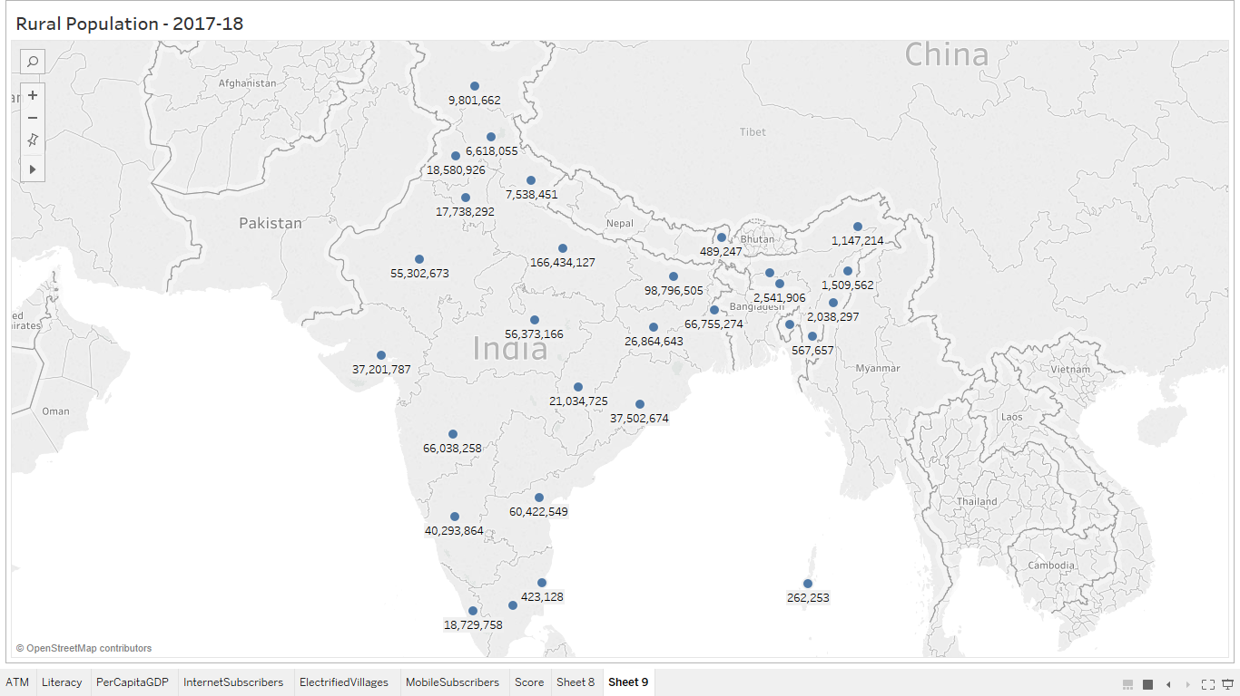
Rural Population
Population Data – 2011 Census
State wise Rural Population
Population growth rates across 2011-17

Slide 9
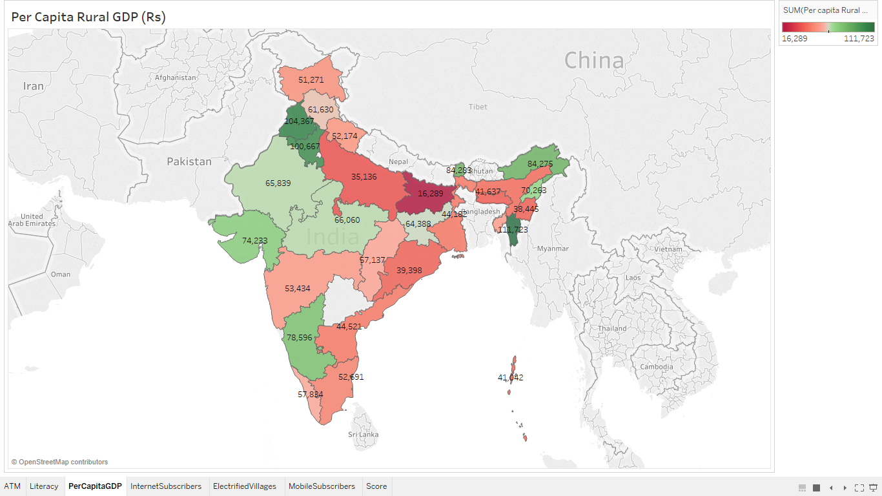
Per Capita Rural GDP
Sector Wise GDP Break up of States
Rural
Urban
Agriculture
Agriculture & allied
Mining
Industry
Manufacturing
Services
GDP of Indian States (2016-17)
GDP Growth Rate for 2017-18 – 6.5%

Slide 10
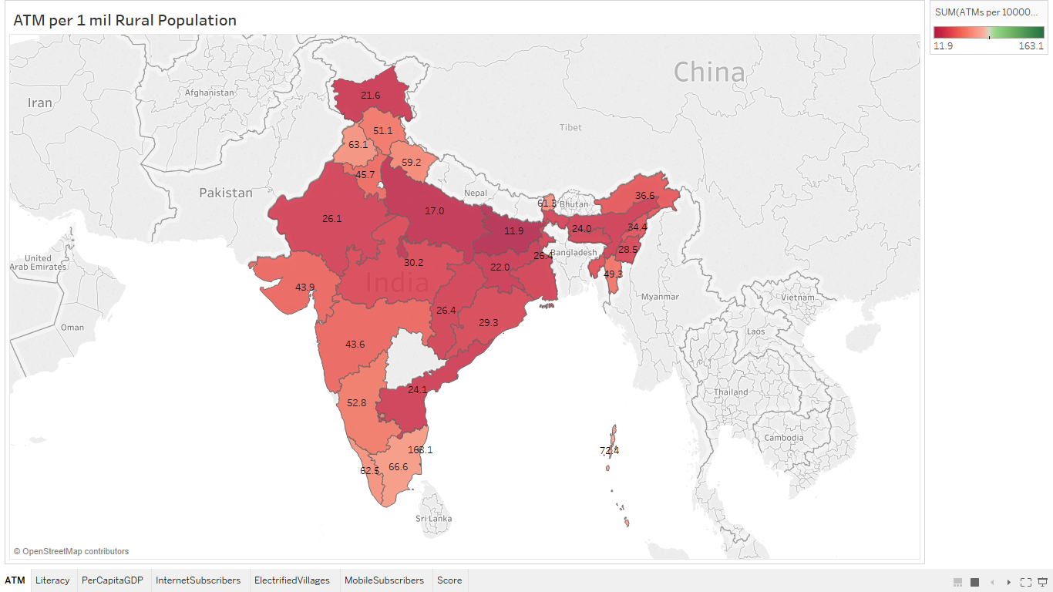
ATM data
State and Bank wise ATM data – June 2018 report
Number of ATMs in rural areas bank wise
Number of ATMs per bank state wise
No of Rural ATMs in the State
Assumption – Mostly Public Banks would be present in rural areas

Slide 11
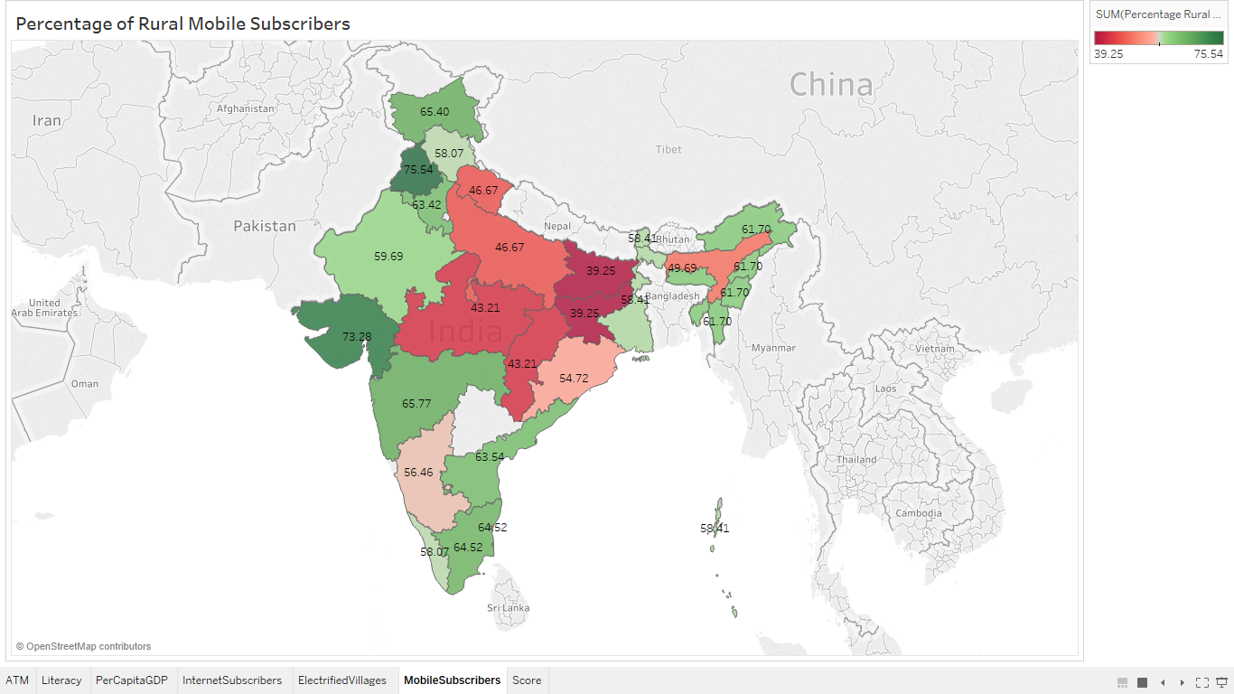
Rural Mobile Subscribers
Circle Wise Mobile Subscribers from TRAI 2018 Report
State wise Percentage of Rural Subscribers

Slide 12
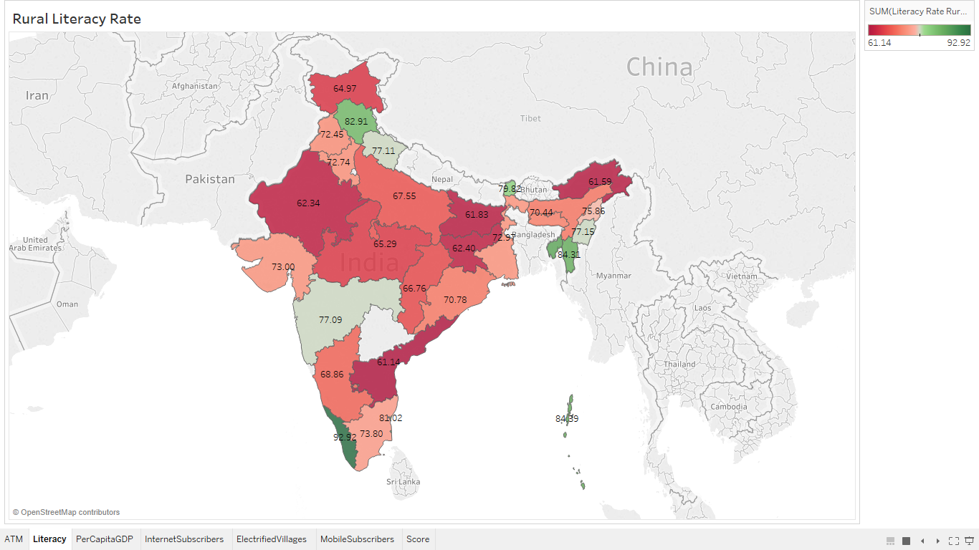
Rural Literacy Rate
Census Data - 2011

Slide 13
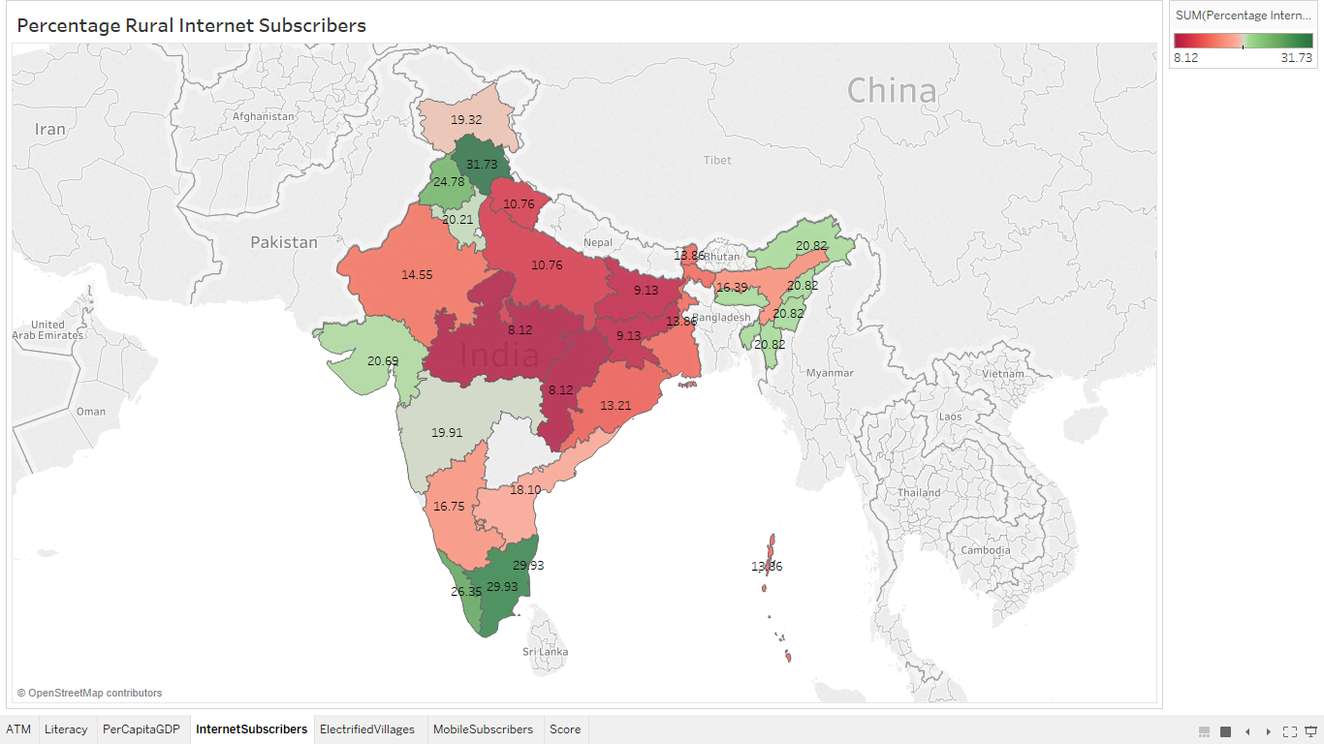
Rural Internet Subscribers
Circle Wise Internet Subscribers from TRAI 2018 Report
State wise Percentage of Rural Subscribers

Slide 14
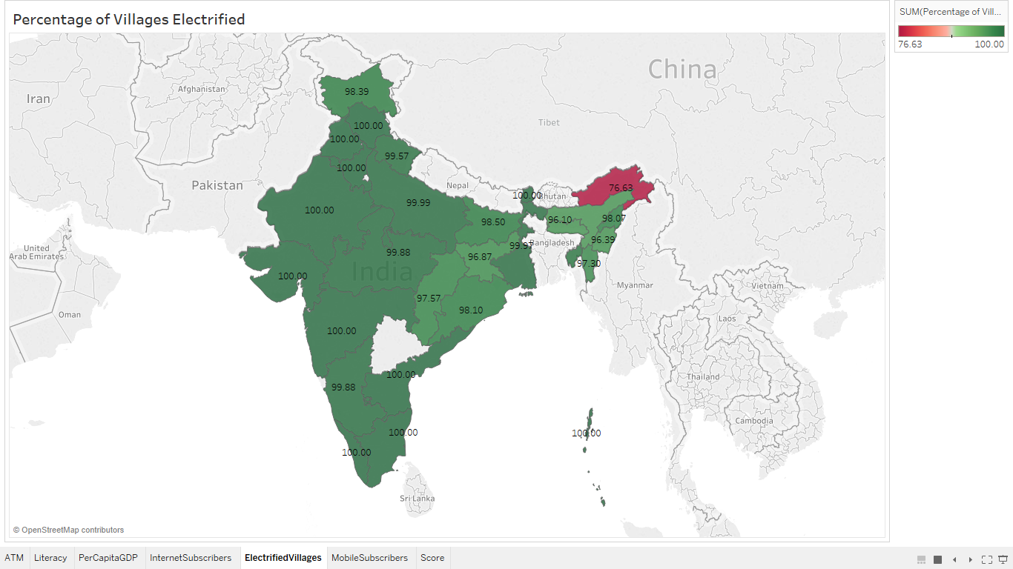
Villages Electrified
State wise cumulative percentage of electrified villages as on 31.1.2017

Slide 15
Digital Index
Digital Index
ATM Score
Literacy Score
Per Capita GDP Score
Internet Score
Electricity Score
Mobile Score
Obtaining the score for each indicator
Indicator value
Converted to quantiles
Obtained score in the range 1-5

Slide 16
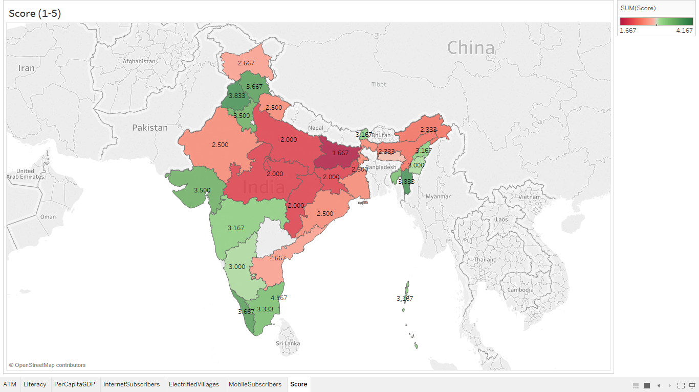
Digital Index
Best Scores (Top 5)
Puducherry
Mizoram
Punjab
Himachal Pradesh
Kerala
Least Scores (Bottom 5)
Bihar
Uttar Pradesh
Jharkhand
Madhya Pradesh
Chhattisgarh

Slide 17
Whom to Target?
Merchants
How to identify the correct merchants?
Utilize the POS data
Assumption : Merchants doing high number of POS transactions will have higher propensity to convert to other modes of digital payments
26 merchant categories with 1300+ POS transactions - High propensity to convert to UPI
Remaining 206 merchant categories - Low propensity to convert to UPI
UPI Maximum amount is INR 1,00,000 which is more than the upper limit of POS transaction(INR 50,000)
Thus, all merchants are our potential targets

Slide 18
Feature Engineering on POS data and Modelling
Aggregated data on Monthly level
Built Features to capture the following information:-
Number of merchants - within the month and on overall level
Amount of transaction – Sum, Maximum, Minimum, Average – within the month
Number of unique Pin codes, Number of unique Regions – within the month
Number of unique Pin codes, Number of unique Regions – on overall level
Number of unique customers – within the month and on overall level
Number of Approved transactions, Declined Transactions(split by reason of declining)
Number of unique customers lying in cluster 1,2,3 – within the month and on overall level

Slide 19
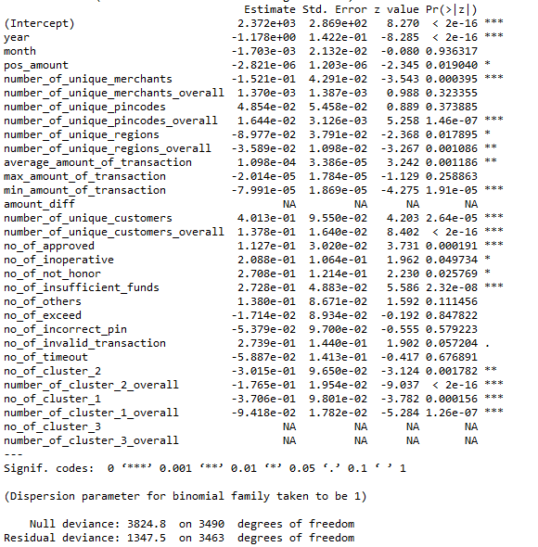
Feature Importance to identify Merchants with high propensity to convert to UPI
Number of Unique Customers
Number of Approved Transactions
Average Amount of Transactions
Number of unique PinCodes, but not number of Region
Minimum Amount of Transaction negatively impacts the propensity

Slide 20
How Customer Clusters were built?
Utilized NFS data
Applied K-Means clustering on the NFS data with new features built on the data
Feature Engineering performed to capture the following information on Monthly Level:-
Total Number of transactions performed by the card holder - Number of Withdrawals, Enquiries, Mini-statement, PinChange, Others
Total Amount of transaction
Account type of the card/transaction
Number of Approved Transactions, Number of Declined Transactions
Number of Unique Pin Codes in which transactions have been performed

Slide 21
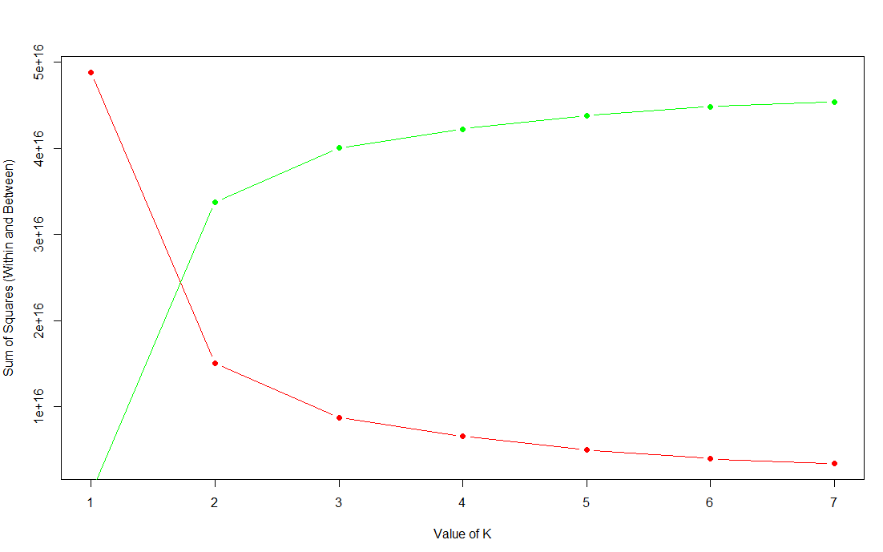
Number of Clusters
Decided number of clusters from scree plot
Ideal number of clusters is 2
Added a variable for cluster number in the NFS data against each card number
Combined the cluster data with POS data
Assigned cluster = 3 for card numbers that were not present in NFS data

Slide 22
Why would banks and merchants move from POS machines to UPI?
Banks
Costs anywhere between Rs 1,200 to 2,500 to just acquire a merchant
Costs INR 8,000 – 10,000 for a POS machine
An average monthly cost of INR 250 per terminal for maintenance
In return, acquiring banks would earn a paltry 5 to 8 basis point
Merchants
Have to pay between 1-2 percent fees on digital payments
Additional monthly and annual charges, depending on merchant type and geography
Mobile Payment methods make mobiles a POS device

Slide 23

How it works
Step 3
Step 2
Promotion through Loyalty Programs and Incentives for different Digital Payment Methods
Step 1
Finding the right merchants and right Digital Payment Methods for them
Target the Areas with people having higher propensity to switch to Digital Payments
Scale
Extend
Leverage

Slide 24
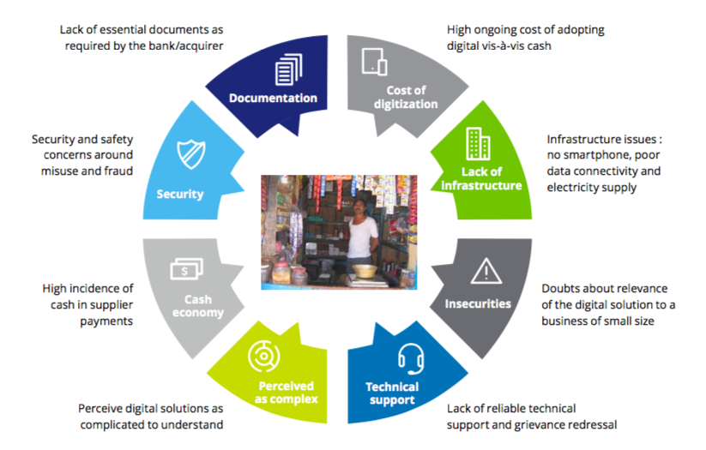
Key Pain points of Merchants

Slide 25





Propensity of Adoption of Payment Technologies in India
Payment Technology | Potential Use Cases | Propensity for Adoption in India
Invisible/ Contactless Payments | Organised Retail Hospitality, Entertainment Chains
Voice- Based Payments | Banking Transactions P2P payments
Social Media Payments | Non financial banking transactions P2P payments
Biometric Payments | Banking Transactions Bill Payments
Audio Based Payments | P2P Payments Merchant Payments

Slide 26
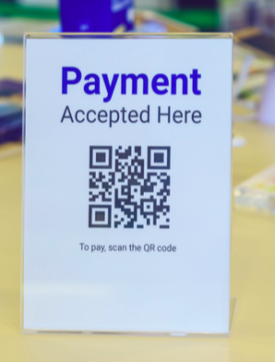
Promotions, Incentives and Loyalty Programmes
Customer Level
Find patterns in Spending behavior and incentivize transactions
Provide Cash Back on first few transactions to retain and gain confidence
Remove Charges on transactions from wallet to bank account
User-friendly Interface
Maintain Secure transaction while ensuring ease of transaction
Merchant Level
Merchant Cashbacks
GST Tax breaks
Reimbursement of Online Payment charges up to a certain limit

Slide 27
Future Scope
Use of more Recent and Granular data to identify regions with high propensity of using digital transactions
Use of more Macroeconomic Indicators to identify regions
Incorporate Drill Down analysis capability from state level to city or village level
Use of Merchant Level Data for in depth analysis of features that increase likelihood of adopting digital methods
Incorporate data of Government Schemes and Policies as feedback in the model

Slide 28
References
Data Sources –
http://niti.gov.in/content/population-number-male-female-rural-urban
https://www.statista.com/statistics/271308/population-growth-in-india/
http://planningcommission.nic.in/data/datatable/data_2312/DatabookDec2014 76.pdf
https://en.wikipedia.org/wiki/List_of_Indian_states_and_union_territories_by_GDP
https://rbidocs.rbi.org.in/rdocs/STATEREGION_ATM/PDFs/ATMD062018EE1E6DCBB9BF492380E1CA6EA9E2AC96.PDF
https://www.trai.gov.in/sites/default/files/YPIRReport04052018.pdf
https://data.gov.in/catalog/progress-report-village-electrification

Slide 29





The Team
Deepanshi Seth
Abhi Jain
Piyush Choudhary
Abhishek Gupta
Pratesh Jhari
PGDBA, IIM C
PGDBA, IIM C
PGDBA, IIM C
PGDBA, IIM C
PGDBA, IIM C

Slide 30
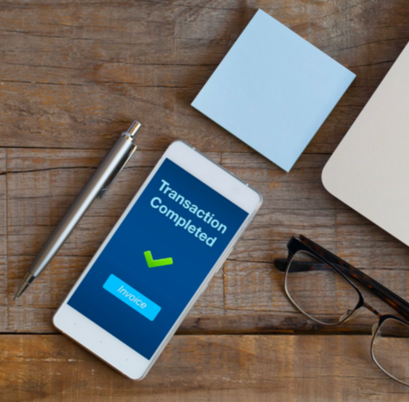
THANK YOU

